Slide 1
KS1 SATs
May
2023
Things we will cover:-
What are SATs in Key Stage 1?
What do the SATs tests look like?
How do teachers assess/results?
Age related expectations
What can you do to help?
A parents guide for schools
applefortheteacher.co.uk

Slide 2
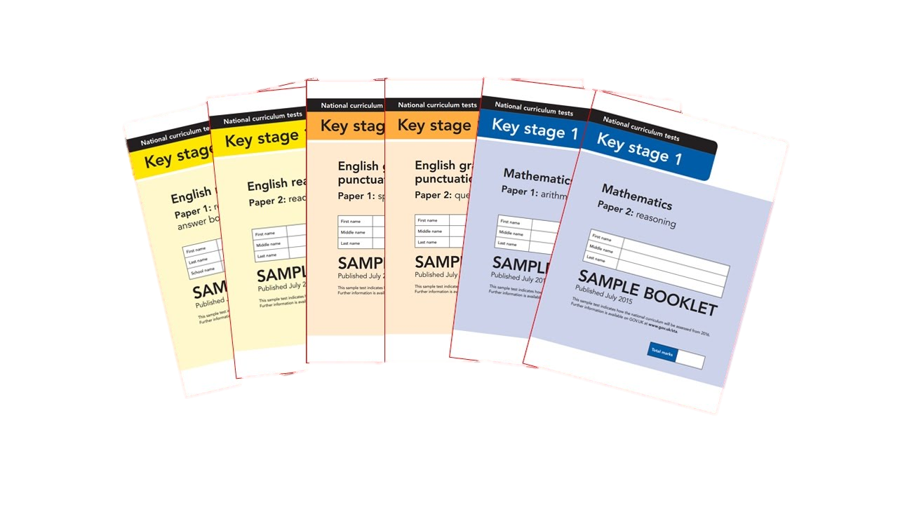
What are Sats?
At the end of Year 2, children in England sit national tests in the following subjects, the results are used to measure the school’s performance:-
*English – Reading
*English – Grammar, Punctuation & Spelling
*Maths – Arithmetic & Reasoning
These tests reflect the updated national curriculum and are marked using the current grading system.
applefortheteacher.co.uk

Slide 3
When are Sats?
When and how do the SATs take place?
•The school is required to administer SATs throughout the month of May, and all schools in England will be carrying out SATs at this time.
•If children are absent, they will have to do the test on return to school.
•We do not want children to worry or become stressed with these SAT’s. To ensure this happens, the children will take the tests with adults that are familiar to them in areas they are used to working in.
applefortheteacher.co.uk

Slide 4
An outline of the tests
Paper 1
Paper 2
Reading booklet with
questions and answer spaces
combined.
Reading booklet with a separate booklet which has the questions and answer spaces.
English Reading
The texts will cover a range of poetry, fiction and non-fiction.
Questions are designed to assess the comprehension and understanding of a child’s reading.
applefortheteacher.co.uk

Slide 5
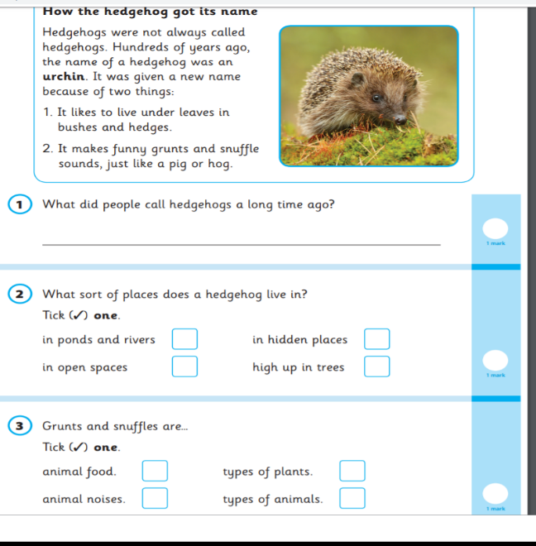
English – Reading Paper 1 Example Page
applefortheteacher.co.uk

Slide 6
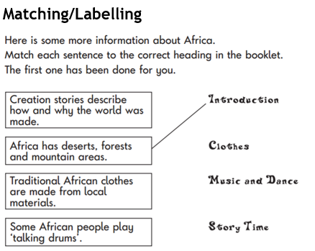
English – Reading Paper 1 Example Page
applefortheteacher.co.uk

Slide 7
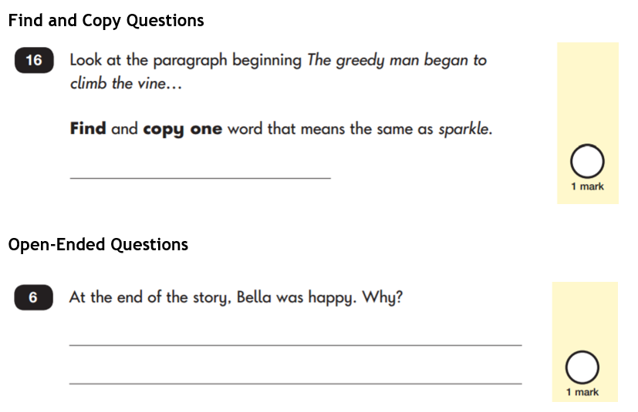
English – Reading Paper 1 Example Page
applefortheteacher.co.uk

Slide 8
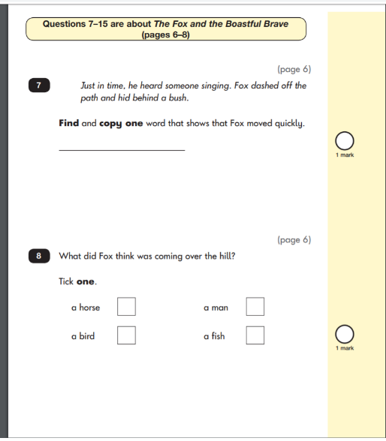
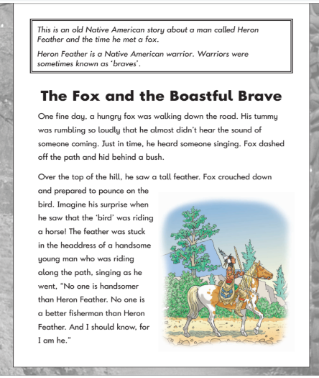
English – Reading Paper 2 Example Pages
applefortheteacher.co.uk

Slide 9
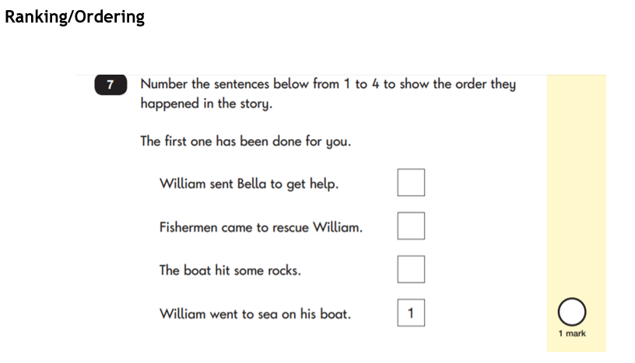
English – Reading Paper 2 Example Pages
applefortheteacher.co.uk

Slide 10
English
English
Spelling, Punctuation & Grammar
Paper 1
Spelling test of 20 words
Paper 2
Question Paper to check grammar, punctuation and vocabulary
applefortheteacher.co.uk

Slide 11
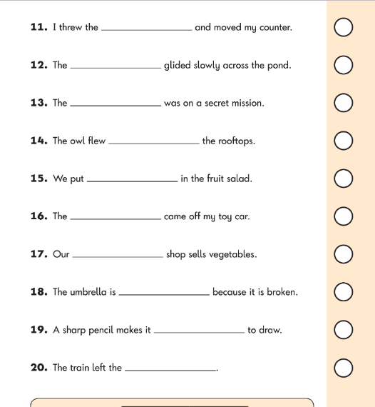
English – Spelling Example Page
English – Grammar Example Page
applefortheteacher.co.uk

Slide 12
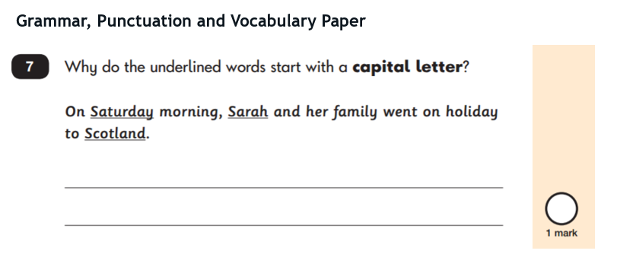
English – Grammar Example Page
applefortheteacher.co.uk

Slide 13
Maths
Paper 1
Paper 2
Arithmetic
Reasoning, problem solving and mathematical fluency
Arithmetic
& Reasoning
(25 marks available)
(35 marks available)
applefortheteacher.co.uk

Slide 14
Maths
Children will sit two tests:
Paper 1 is for arithmetic. It covers calculation methods for all operations.
Paper 2 includes five aural questions. Pupils will still require calculation skills and questions will be varied including multiple choice, matching, true/false, completing a chart or table or drawing a shape. Some questions will also require children to show or explain their working out.
Arithmetic
& Reasoning
applefortheteacher.co.uk

Slide 15
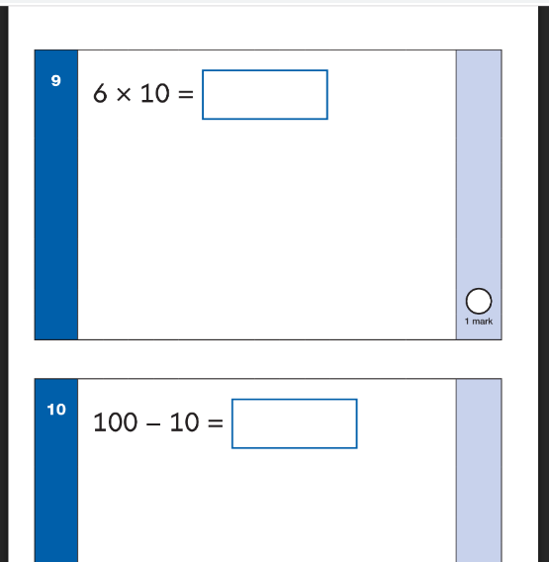
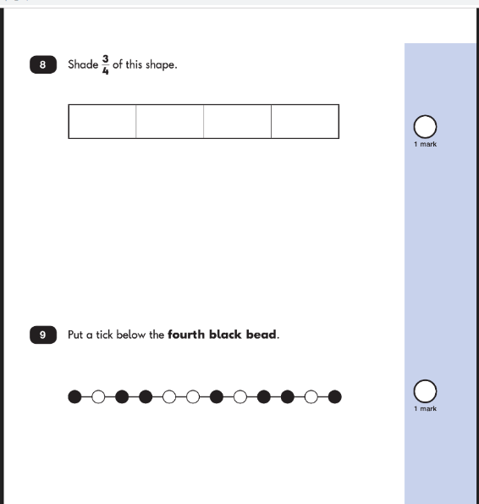
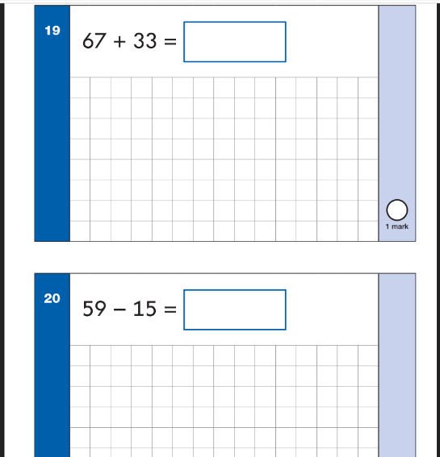
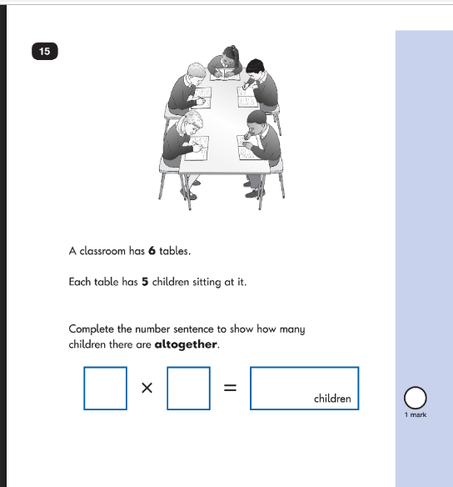
Maths Paper 1 Example Pages (Arithmetic)
Maths Paper 2 Example Pages (Reasoning)
applefortheteacher.co.uk

Slide 16
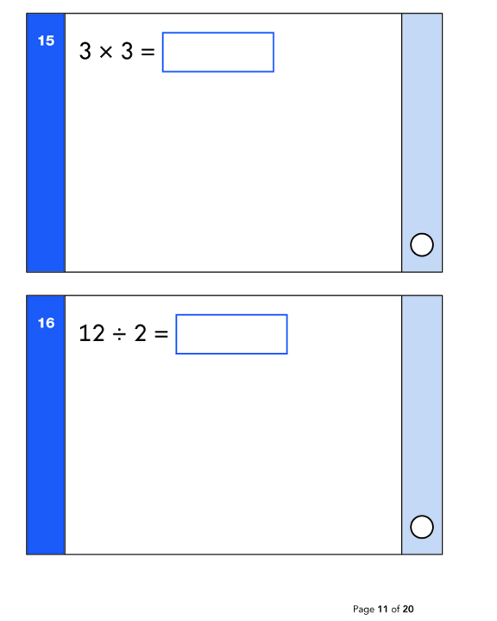
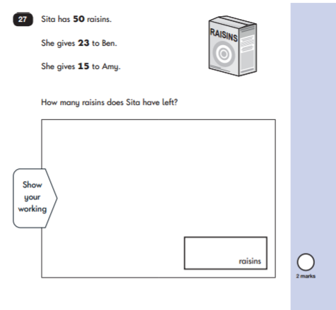
Maths Paper 1 Example Pages (Arithmetic)
Maths Paper 2 Example Pages (Reasoning)
applefortheteacher.co.uk

Slide 17
Teacher Assessment/results
KS1 SATs tests are one part of evidence towards the whole teacher assessment.
They are marked in school, and an overall grading based on the whole year’s work
will be made.
The results of the SATs tests are
reported to the Local Authority.
Moderation often takes place to ensure consistency across schools.
applefortheteacher.co.uk

Slide 18
Age Related Expectations
Working below the expected standard (not working within the Year 2 Curriculum).
Working towards the expected standard (some of the learning is within the Year 2 Curriculum).
Working at the expected standard (All learning is within the Year 2 Curriculum).
Working at greater depth (very secure in Year 2 Curriculum, with elements of Year 3).
applefortheteacher.co.uk

Slide 19
How can you help your child prepare?
First and foremost, support and reassure your child that there is nothing to worry about and that they should always just try their best. Praise and encourage!
Ensure your child has the best possible attendance at school.
Support your child with any homework tasks.
Reading, spelling and arithmetic (e.g. times tables) are always good to practise.
Talk to your child about what they have learnt at school and what book(s) they are reading (the character, the plot, their opinion).
Make sure your child has a good sleep and healthy breakfast every morning!

Slide 20
How to help your child with reading
Listening to your child read can take many forms:
First and foremost, focus developing an enjoyment and love of reading.
Enjoy stories together – reading stories to your child is equally as important as listening to your child read.
Read a little at a time but often, rather than rarely and for longer periods of time!
Talk about the story before, during and afterwards – discuss the plot, the characters, their feelings and actions, how it makes you feel, predict what will happen and encourage your child to have their own opinions.
Look up definitions of words together – you could use a dictionary, the Internet or an app on a phone or tablet.
All reading is valuable – it doesn’t have to be just stories. Reading can involve anything from fiction and non-fiction, poetry, newspapers, magazines, football programmes, TV guides.
Visit the local library - it’s free!
applefortheteacher.co.uk

Slide 21
How to help your child with writing
Practise and learn weekly spellings – make it fun. Can they write silly sentences using their weekly spellings?
Encourage as many opportunities for writing as possible, such as letters to family or friends, shopping lists, notes or reminders, stories or poems, holiday recounts using their favourite photo.
Write together – be a good role model for writing.
Encourage use of a dictionary to check spelling.
Remember that good readers become good writers! Identify good writing features when reading (e.g. vocabulary, exciting sentences with lots of detail, punctuation).
Show your appreciation: praise and encourage, even for small successes!
applefortheteacher.co.uk

Slide 22
How to help your child with maths
Play times tables games – School 360 using J2blast
Play mental maths games including counting in different amounts (2’s, 3’s, 5’s and 10’s), forwards and backwards. – ICT games has lots of different games to play and support this.
Encourage opportunities for telling the time.
Encourage opportunities for counting coins and money e.g. finding amounts or calculating change when shopping.
Look for examples of 2D and 3D shapes around the home.
Identify, weigh or measure quantities and amounts in the kitchen or in recipes.
Play games involving numbers or logic, such as dominoes, card games and matching games.
applefortheteacher.co.uk

Slide 23
Don’t Worry!!!
Don’t Worry!
•Whilst SATs are statutory, teachers will be assessing your child’s progress throughout the year.
•This means that the scores that your child achieves in the SATs are just one part of the assessment process.
•Your child’s final end of year results are determined by the teacher and not the tests!
applefortheteacher.co.uk

Slide 24
Questions
Any Questions?
We hope this will give you an idea of what the SATs involve.
If you have any questions please do not hesitate to ask your child’s class teacher
Thank you for coming!
applefortheteacher.co.uk

Slide 25
Thank You!
Your time is appreciated.

