Slide 1
Year One
Phonics Screening Check
A Guide for Parents

Slide 2
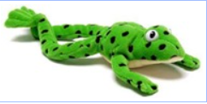
What is Phonics?
Children begin to learn phonics (sounds) in early years, both nursery and reception. Once children begin learning sounds, these sounds are used orally to identify and make words. They will then begin to learn the letters which make each of the sounds and these are used to read and spell words.
Once children begin learning sounds, these sounds are used orally to identify and make words. They will then begin to learn the letters which make each of the sounds and these are used to read and spell words.

Slide 3
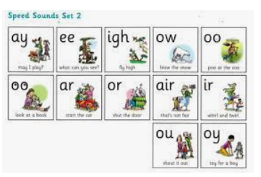
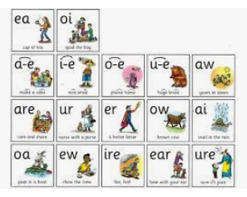
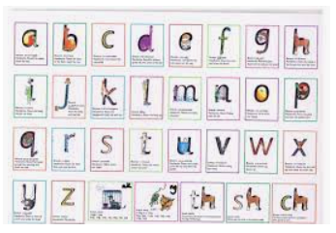
Read Write Inc
Read Write Inc is the phonics programme that we
follow to support our phonic teaching.
The phonemes are broken up into 3 different sets
Set 1 – these are individual sounds that the children learn first

Slide 4
Read Write Inc
Set 2 – the children are introduced to the term ‘special friends’. This is where two or three letters join together to make a new sound (Phoneme)

Slide 5
Read Write Inc
Set 3 – the children are introduced to ‘chatty friends’ also known as a ‘split diagraph’. This is where 2 letters are split up by another letter eg – time, hope, name.
This is also where children start to understand that there is more than one way to spell the different sounds.
We try to encourage all the children to look for ‘special friends’ and ‘split diagraphs’ when they are reading unfamiliar words.

Slide 6
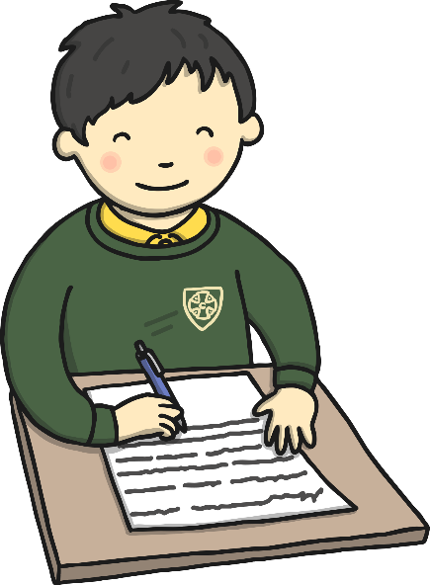
What is the Phonics Screening Check?
Children in Year 1 throughout the country will all be taking part in a phonics screening check during the week of the 12th June. This is the first week back after the half term holiday!
Children in Year 2 will also take the check if they did not achieve the required result when in Year 1 or they have not taken the test before.
The phonics screening check is designed to confirm whether individual children have learnt phonic decoding and blending skills to an appropriate standard.

Slide 7
What Happens During the Test?
The test contains 40 words. Each child will sit one-to-one and read each word aloud to a teacher. The test will take approximately 10 minutes per child, although all children are different and will complete the check at their own pace. The list of words the children read is a combination of 20 real words and 20 pseudo words (nonsense words).

Slide 8
Pseudo Words (Nonsense Words)
The pseudo words will be shown to your child with a picture of an alien. This provides the children with a context for the pseudo word which is independent from any existing vocabulary they may have. Pseudo words are included because they will be new to all pupils; they do not favour children with a good vocabulary knowledge or visual memory of words.

Slide 9
Reporting to Parents
By the end of the summer term all schools must report each child's results to their parents. They will also confirm if the child has met the standard threshold. Children who do not achieve the expected level will retake the test when they are in Year 2.

Slide 10
How Can I Help My Child at Home?
Play lots of sound and listening games with your child.
Read as much as possible to and with your child.
Encourage and praise – get them to have a ‘good guess’.
If your child is struggling to decode a word, help them by encouraging them to say each sound in the word from left to right.
Blend the sounds by pointing to each one, e.g. /c/ in cat, /p/ in pat, /ng/ in sing, /ee/ in been. Next move your finger under the whole word as you say it.
Discuss the meaning of words if your child does not know what they have read.

Slide 11
QR code
We are sending home some extra word reading practice in your child’s reading diary. All you need to do is use a QR scanner and access the words.

