Slide 1
KS1
Standard Assessment Tests
Parent and Carer Meeting
March 2017

Slide 2
What are SATs?
•At the end of Key Stage 1 all children are required to be tested in different areas of Maths and English.
•Throughout the year teachers will be preparing children for these tests.
•Tests inform Teacher Assessments that are submitted to the government at the end of the year.
*The tests are just one part of a range of assessments which have been carried out throughout your child’s time in KS1.

Slide 3
In recent years, ‘old’ national curriculum levels (e.g. Levels 1, 2, 3) have been abolished as set out in the government guidelines. Children are now described as working towards, working at and working at greater depth according to the Year 2 expectations of the new curriculum.
The new curriculum is more rigorous and sets high expectations, which all schools have had to work hard to meet in the last two years.

Slide 4
When and how do the SATs take place?
•The school is required to administer SATs during the month of May, and all schools in England will be carrying out SATs at this time.
•If children are absent, they will have to do the test on return to school.
•We do not want children to worry or become stressed with these SAT’s. To ensure this happens, the children will take the tests with adults that are familiar to them in areas they are used to working in.

Slide 5
The Tests
•At the end of Year 2, children will take assessments in:
•Reading
•English grammar, punctuation and spelling;
•Maths
*There is no test for English Writing. Children are assessed throughout the year with writing tasks.

Slide 6
The Reading Test consists of two separate papers:
•Paper 1 – Contains a variety of texts with questions.
•Paper 2 – Contains a separate reading booklet.
Children will write their answers to questions about the passage in a separate booklet.
• Children are given time to complete as much of the paper as possible
•The texts will cover a range of poetry, fiction and non-fiction.
•Questions are designed to assess the comprehension and understanding of a child’s reading.

Slide 7
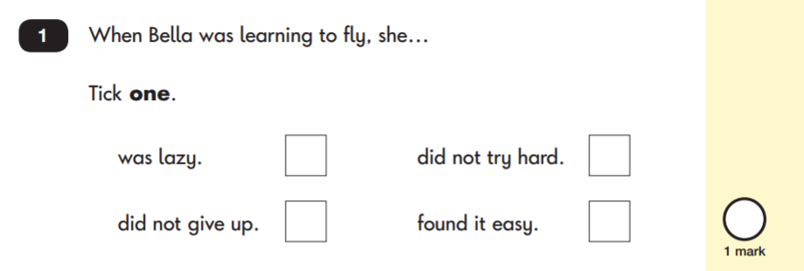
Reading: Sample Questions
Questions are designed to assess the comprehension and understanding of a child’s reading.
There are a variety of question types:
Multiple Choice
chapter
menu
next page

Slide 8
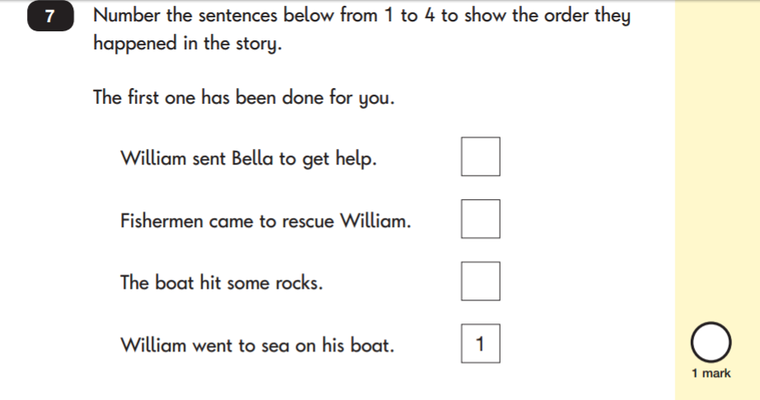
Reading: Sample Questions
Ranking/Ordering
chapter
menu
next page

Slide 9
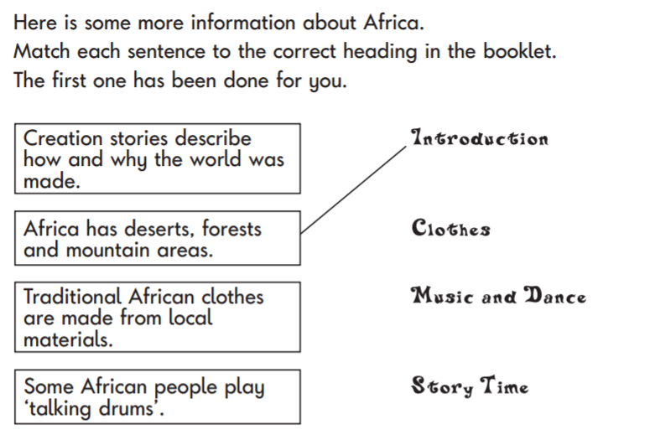
Reading: Sample Questions
Matching/Labelling
Short-Answer Questions
chapter
menu
next page

Slide 10
click to see all text
Reading: Sample Questions
Find and Copy Questions
Open-Ended Questions
chapter
menu
next page

Slide 11
Spelling, Punctuation and Grammar
The test consists of two separate papers:
•Paper 1: spelling (20 marks).
•Paper 2: questions (20 marks).

Slide 12
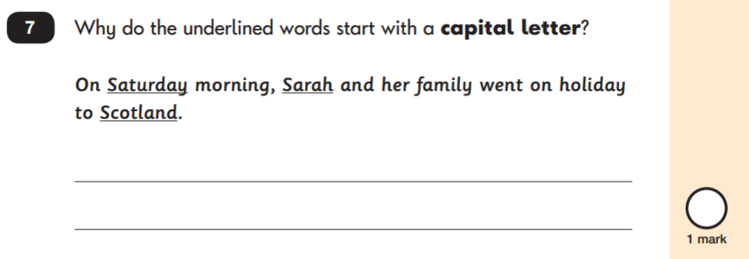
Grammar, Punctuation & Spelling: Sample Questions
Grammar, Punctuation and Vocabulary Paper
chapter
menu
next page

Slide 13
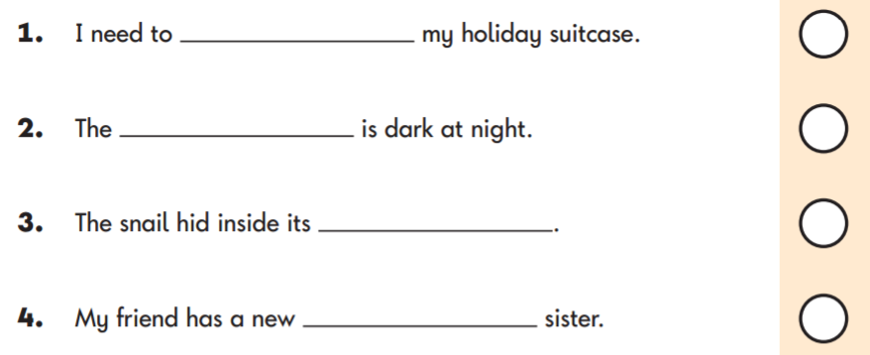
Grammar, Punctuation & Spelling: Sample Questions
Spelling Paper
chapter
menu
Within the assessment, the spelling words are read out to the children to fill into the gaps within the sentences. In this example, the missing spelling words are: pack, sky, shell and baby.
next page

Slide 14
Mathematics
Children will sit two tests:
•Paper 1 is for arithmetic. It covers calculation methods for all operations.
•Paper 2 includes five aural questions. Pupils will still require calculation skills and questions will be varied including multiple choice, matching, true/false, completing a chart or table or drawing a shape. Some questions will also require children to show or explain their working out.

Slide 15
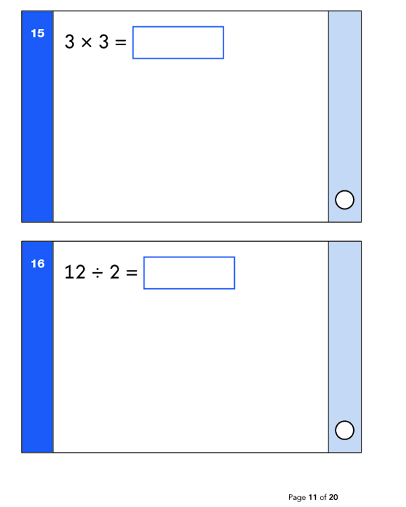
Maths: Sample Questions
Maths Paper 1: Arithmetic
chapter
menu
next page

Slide 16
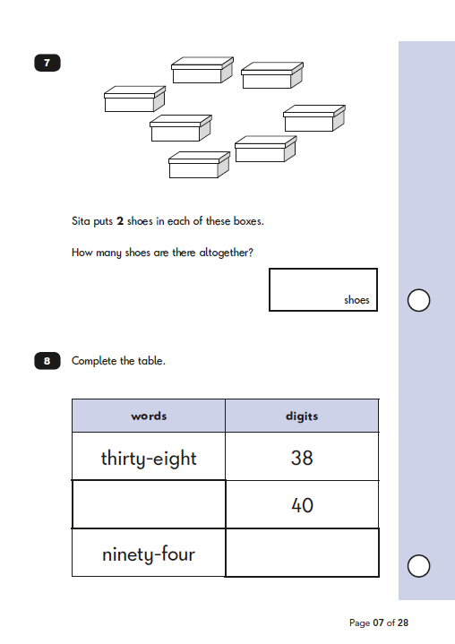
Maths: Sample Questions
Maths Paper 2: Reasoning
chapter
menu
next page

Slide 17
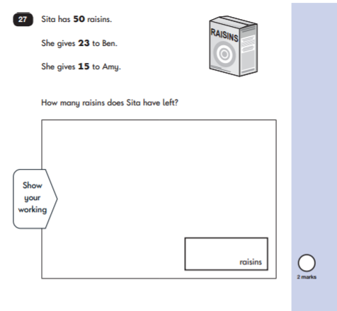
Maths: Sample Questions
Maths Paper 2: Reasoning
chapter
menu
next page

Slide 18
How to Help Your Child
First and foremost, support and reassure your child that there is nothing to worry about and that they should always just try their best. Praise and encourage!
Ensure your child has the best possible attendance at school.
Support your child with any homework tasks.
Reading, spelling and arithmetic (e.g. times tables) are always good to practise.
Talk to your child about what they have learnt at school and what book(s) they are reading (the character, the plot, their opinion).
Make sure your child has a good sleep and healthy breakfast every morning!
First and foremost, support and reassure your child that there is nothing to worry about and that they should always just try their best. Praise and encourage!
Ensure your child has the best possible attendance at school.
Support your child with any homework tasks.
Reading, spelling and arithmetic (e.g. times tables) are always good to practise.
Talk to your child about what they have learnt at school and what book(s) they are reading (the character, the plot, their opinion).
Make sure your child has a good sleep and healthy breakfast every morning!

Slide 19
How to Help Your Child with Reading
Listening to your child read can take many forms:
First and foremost, focus developing an enjoyment and love of reading.
Enjoy stories together – reading stories to your child is equally as important as listening to your child read.
Read a little at a time but often, rather than rarely but for long periods of time!
Talk about the story before, during and afterwards – discuss the plot, the characters, their feelings and actions, how it makes you feel, predict what will happen and encourage your child to have their own opinions.
Look up definitions of words together – you could use a dictionary, the Internet or an app on a phone or tablet.
All reading is valuable – it doesn’t have to be just stories. Reading can involve anything from fiction and non-fiction, poetry, newspapers, magazines, football programmes, TV guides.
Visit the local library - it’s free!
Listening to your child read can take many forms:
First and foremost, focus developing an enjoyment and love of reading.
Enjoy stories together – reading stories to your child is equally as important as listening to your child read.
Read a little at a time but often, rather than rarely but for long periods of time!
Talk about the story before, during and afterwards – discuss the plot, the characters, their feelings and actions, how it makes you feel, predict what will happen and encourage your child to have their own opinions.
Look up definitions of words together – you could use a dictionary, the Internet or an app on a phone or tablet.
All reading is valuable – it doesn’t have to be just stories. Reading can involve anything from fiction and non-fiction, poetry, newspapers, magazines, football programmes, TV guides.
Visit the local library - it’s free!

Slide 20
How to Help Your Child with Maths
Play times tables games.
Play mental maths games including counting in different amounts, forwards and backwards.
Encourage opportunities for telling the time.
Encourage opportunities for counting coins and money e.g. finding amounts or calculating change when shopping.
Look for numbers on street signs, car registrations and anywhere else.
Look for examples of 2D and 3D shapes around the home.
Identify, weigh or measure quantities and amounts in the kitchen or in recipes.
Play games involving numbers or logic, such as dominoes, card games,
draughts or chess.
Play times tables games.
Play mental maths games including counting in different amounts, forwards and backwards.
Encourage opportunities for telling the time.
Encourage opportunities for counting coins and money e.g. finding amounts or calculating change when shopping.
Look for numbers on street signs, car registrations and anywhere else.
Look for examples of 2D and 3D shapes around the home.
Identify, weigh or measure quantities and amounts in the kitchen or in recipes.
Play games involving numbers or logic, such as dominoes, card games,
draughts or chess.

Slide 21
Any Questions?
We hope this will give you an idea of what the SATs involve.
If you have any questions please do not hesitate to ask any member of staff.
Thank you for coming!

Slide 22
Don’t Panic!
•Whilst SATs are statutory, teachers will be assessing your child’s progress throughout the year.
•This means that the scores that your child achieves in the SATs are just one part of the assessment process.
•Your child’s final end of year results are determined by the teacher and not the tests!

