Slide 1
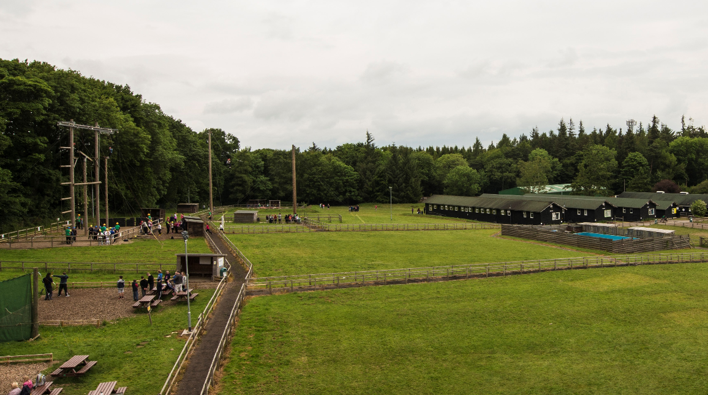

Slide 2
Where?

Slide 3
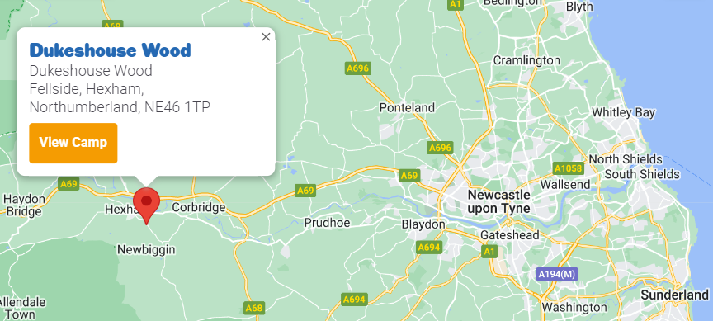
Situated on a beautiful fell side just
outside Hexham, close to Newcastle.

Slide 4
Staffing
Mr Rutherford (Visit Leader)
Mrs Greenwood
Mrs Butler (First Aid)
Miss Donnelly
Mrs Collinson
Mrs Ward

Slide 5
What is available?

Slide 6
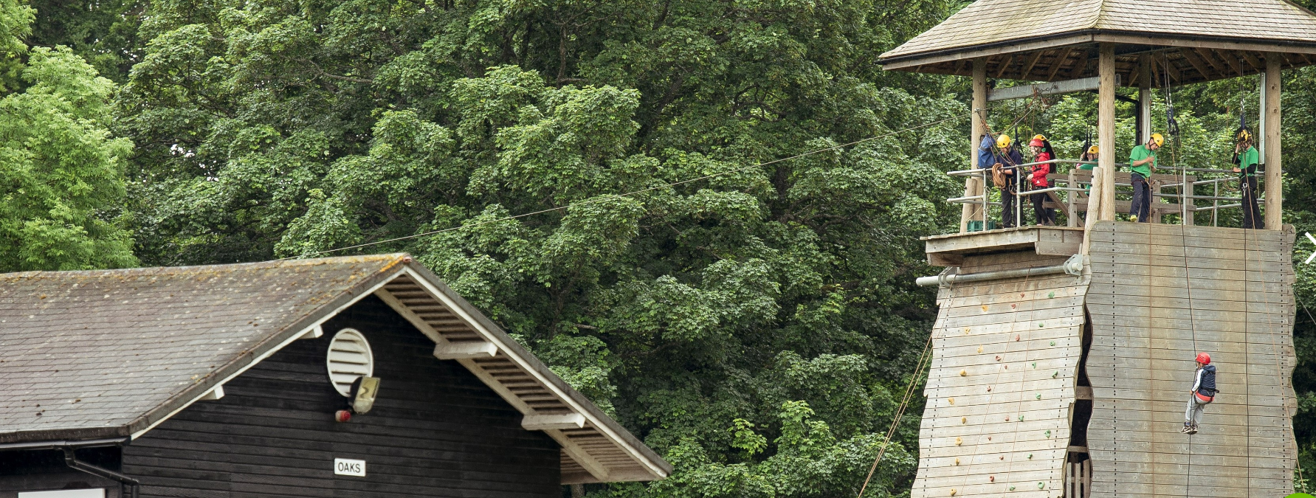
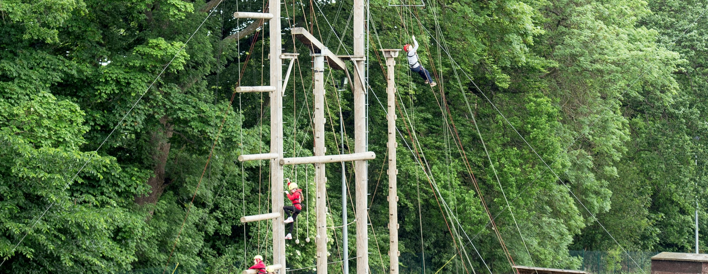
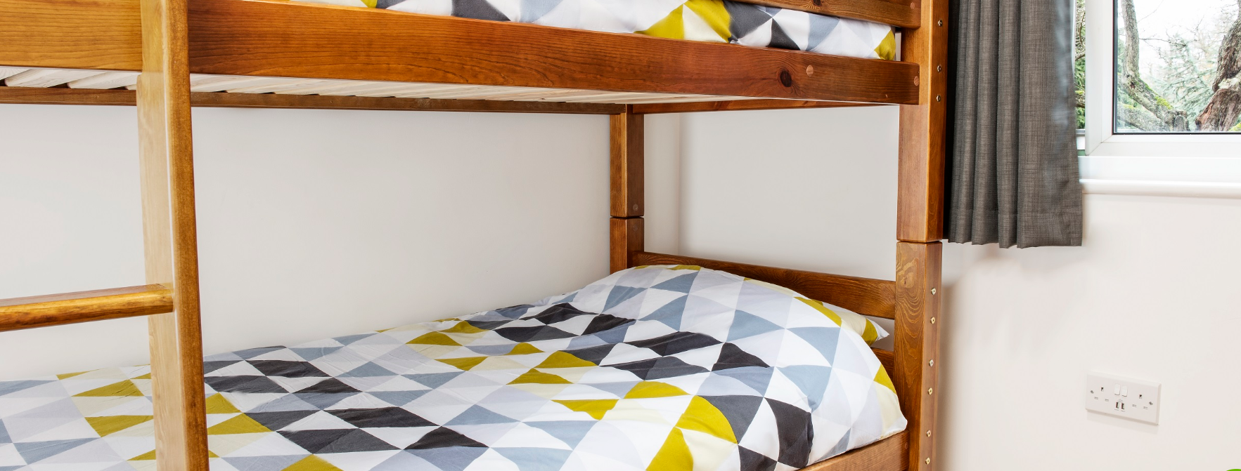
An adventure park equipped with different activities.
We will be undertaking bush craft and 3G swing.
The activity barn provides a perfect environment for indoor climbing and problem-solving initiatives.
Long hair will need to be tied back for most activities – bring bobbles!

Slide 7
In the evenings, all groups will come together for team activities including, mini-Olympic games and time around the campfire.
Over the course of our visit the children will undertake environmental workshops. This includes exploring mini-beasts, exploring sustainability and exploring woods.
A small souvenir shop is available.
Children are recommended to bring no more than £10 to purchase a small gift.

Slide 9
Monday 3rd
October

Slide 10
Monday 3rd October
Please bring your child to the front of school where we will meet in the hall to register and get ready for the bus, which will leave approximately 9:30am.
All medication will be collected.
Please do not bring any valuables or electronics.
Children will need to bring a packed lunch with them. For lunch time on the first day only.

Slide 11
Wednesday 5th
October

Slide 12
Wednesday 5th October
The bus will leave at approximately 1:30pm and should therefore be back to school for around 2:30-3pm.
You will receive a text message with the estimated arrival time. Please do not contact the office, they will contact you.

Slide 13
Accommodation

Slide 14
The Dorms:
Children will be allocated a room suitable for up to 10 children.
Children will be in a group of 5-8 children per room.
Staff bedroom are situated in between the children’s rooms.
All rooms are en-suite.
Children may bring a book to read before going to sleep.

Slide 15
What to pack

Slide 16
What to pack
Toiletries (no aerosols due to sensitive fire alarms)
Clothes – long-sleeved t-shirts and trousers are required for activity sessions. (old clothes are recommended for activity sessions)
Please ensure your child’s name is clearly labelled on the inside of their clothes.
Closed-toed shoes
Waterproof clothing (jacket, trousers and wellingtons)
Large plastic bag for dirty clothing
A bath towel
Sunglasses, sun cream and hat (weather dependant)
Gloves, hat and scarf (weather dependant)
Pyjamas and slippers
Named water bottle
Money (£10 max.) for a souvenir
No electrical equipment or valuable items

Slide 17
Qualities for
development

Slide 18
Qualities for development
Enjoy!
Have fun!

Slide 19
Qualities for development
Enjoy!
Have fun!

